Slide 1
Parallel and Distributed Computing
CS3006
Lecture 4
Network Topologies
28th February 2022
Dr. Rana Asif Rehman

Slide 2
Agenda
A Quick Review
Static Interconnection vs Dynamic interconnections
Some Basic Interconnections
Evaluating Static Interconnections

Slide 3
Quick Review to the Previous Lecture
Flynn’s Taxonomy
SISD
MISD
SIMD
MIMD
PRAM Model
Types
Arbitration protocols
Routing techniques and Costs
Notes:
What and when

Slide 4
Interconnection Networks
Main problem is how to do interconnections of the CPUs to each other and to the memory
There are three main network topologies available:
Crossbar (n² connections – data path without sharing)
Multi-stages network (n log₂ n connections - log₂ n switching stages and shared on a path)
Central databus (1 connections - n shared)

Slide 5
Interconnection Networks
0
OUT
7
CPU
CPU
CPU
0
IN
Crossbar
Network
7
MEM
MEM
MEM
0
0
IN
OUT
0
0
Central databus
IN
OUT
7
7
7
7
Ω-network

Slide 6
Static vs Dynamic Interconnections
Interconnection networks carry data between processors and to memory.
Interconnects are made of processing elements, switches and links (wires, fiber).
Interconnects are classified as static or dynamic.
Static networks consist of point-to-point communication links among processing nodes and are also referred to as direct networks.
Dynamic networks are built using switches and communication links. Dynamic networks are also referred to as indirect networks.
Notes:
Static: point to point
Dynamic: indirect

Slide 7
Static vs Dynamic Interconnections
Classification of interconnection networks: (a) a static network; and (b) a dynamic network.

Slide 8
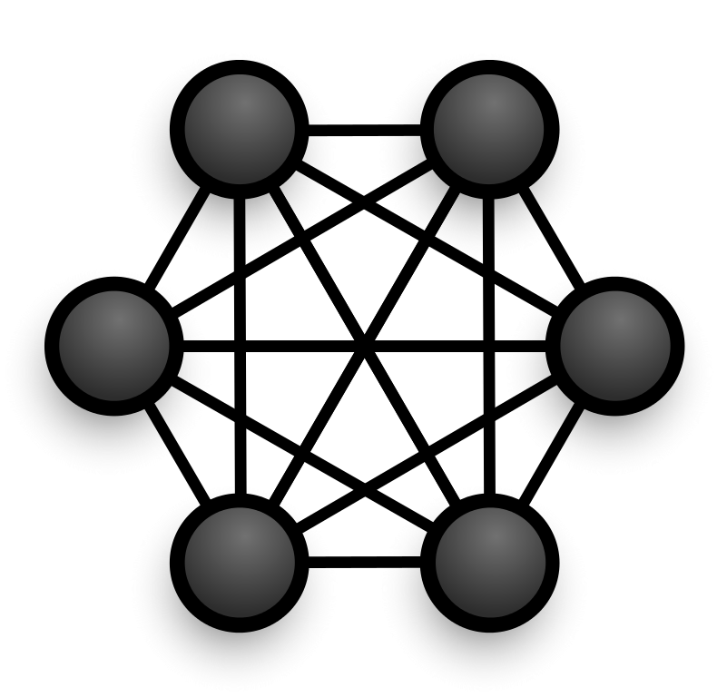
Network Topologies: Linear Arrays, Meshes, and k-d Meshes
Each processor is connected to every other processor (Complete connected network).
The number of links in the network scales as O(p²).
While the performance scales very well, the hardware complexity is not realizable for large values of p.
Star connected networks

Slide 9
Network Topologies: Linear Arrays, Meshes, and k-d Meshes
In a linear array, each node has two neighbors, one to its left and one to its right.
If the nodes at either end are connected, we refer to it as a 1-D torus or a ring.
Linear arrays: (a) with no wraparound links; (b) with wraparound link.
Notes:
Switch is a device that opens or closes access to certain data bank or word

Slide 10
Network Topologies: Linear Arrays, Meshes, and k-d Meshes
Mesh
A generalization has nodes with 4 neighbors, to the north, south, east, and west.
A further generalization to d dimensions has nodes with 2d neighbors (i.e., 6 neighbors in case of 3d cube).
Two and three dimensional meshes: (a) 2-D mesh with no wraparound; (b) 2-D mesh with wraparound link (2-D torus); and (c) a 3-D mesh with no wraparound.
Notes:
3d-weather modeling, 3d-structure modeling

Slide 11
Network Topologies: Linear Arrays, Meshes, and k-d Meshes
Hypercube
The hypercube has two nodes along each dimension except 0d hypercube.
d = log p (dimensions = log(nodes))
The distance between any two nodes is at most log p.
Each node has log p neighbors.
The distance between two nodes is given by the number of bit positions at which the two nodes differ.
Rule of thumb is: “d-dimensional hypercube can be constructed by connecting corresponding nodes of two (d-1)-dimensional hypercubes”

Slide 12
Network Topologies: Linear Arrays, Meshes, and k-d Meshes

Slide 13
Network Topologies: Tree based Networks
A tree network is one in which there is one path between any pair of nodes
Linear arrays and star-connected networks are special cases of tree-based networks
In static tree network, each node represent a processing element
In dynamic tree network, leaf nodes represent processing element while internal nodes are switching elements.
The source node sends the message up the tree until it reaches the node at the root of the smallest subtree containing both the source and destination nodes.

Slide 14
Network Topologies: Tree based Networks
Complete Binary Tree
Complete binary tree networks: (a) a static tree network; and (b) a dynamic tree network.

Slide 15
Network Topologies: Tree based Networks
Properties of Complete Binary Tree Network
The distance between any two nodes is no more than 2logp.
Links higher up the tree potentially carry more traffic than those at the lower levels.
For this reason, a variant called a fat-tree, fattens the links as we go up the tree.
Trees can be laid out in 2D with no wire crossings. This is an attractive property of trees.

Slide 16
Network Topologies: Tree based Networks
Properties of Complete Binary Tree Network
A fat tree network of 16 processing nodes.

Slide 17
Evaluating Static Interconnections
The parameters to evaluate a static interconnection:-
Cost: Usually depends on number of links for communication. E.g., cost for linear array is p-1.
Lower values are favorable
Diameter: The shortest distance between the farthest two nodes in the network. The diameter of a linear array is p − 1.
Lower values are favorable
Bisection Width: The minimum number of wires you must cut to divide the network into two equal parts. The bisection width of a linear array is 1.
What it tells about performance of a topology?
Notes:
Bisection width is related to available bandwidth of the network when first half of network communicates with second half of the network
Our performance increases as no. of dimensions increase

Slide 18
Evaluating Static Interconnections
The parameters to evaluate a static interconnection:-
Arc-connectivity: The minimum number of arcs or links that must be removed from the network, to break the network into two disconnected networks
Higher value are desirable
It is minimum number of the links that must be cut to separate the single node from the network
Higher values means, that incase of link failure there are multiple other routes to the node.
Arc-connectivity of linear array is 1 and 2 for ring.

Slide 19
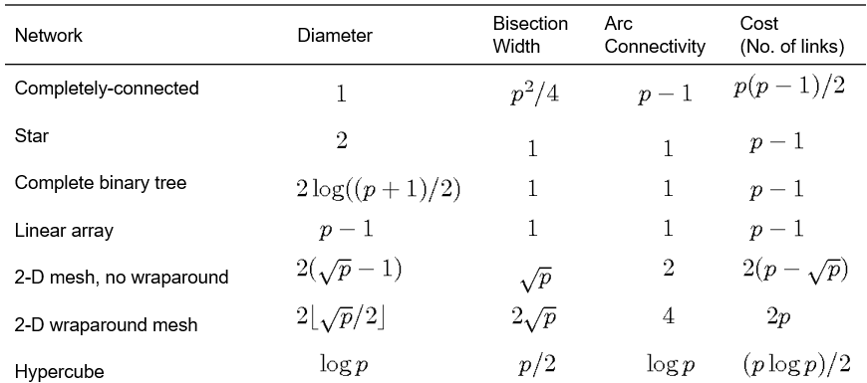
Evaluating Static Interconnections
Notes:
log(p+1)-1 floors of links in binary trees→ Exponential formula=2^0 + 2^1+…+2^n=2^(n+1) -1
To solve hypercube induce concept of directed links
Star bisection= not ⎣ p/2 ⎦ but 1 because we only have one link to transfer data to second half
Determine expressions for all the interconnections
Discuss scalability issues→ How adding or removing a node effects overall network

Slide 20

Questions

Slide 21
References
Flynn, M., “Some Computer Organizations and Their Effectiveness,” IEEE Transactions on Computers, Vol. C-21, No. 9, September 1972.
Kumar, V., Grama, A., Gupta, A., & Karypis, G. (1994). Introduction to parallel computing (Vol. 110). Redwood City, CA: Benjamin/Cummings.
Quinn, M. J. Parallel Programming in C with MPI and OpenMP,(2003).

Slide 22
Cache Coherence and snooping
In a snooping system, all caches on the bus monitor (or snoop) the bus to determine if they have a copy of the block of data that is requested on the bus.
Every cache has a copy of the sharing status of every block of physical memory it has.
Snooping Protocol Types
Write-invalidate (mostly used)
The processor that is writing data causes copies in the caches of all other processors in the system to be rendered invalid before it changes its local copy.
Write-update
The processor that is writing the data broadcasts the new data over the bus
All caches that contain copies of the data are then updated

